Slide 1

Model comparison of hate speech detection across different social media platforms.
BY:
SWATI THAPA (210151488)

Slide 2
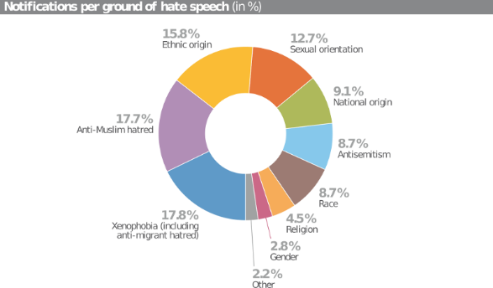
What is the problem?
As the internet is becoming easy to access worldwide, hate speech increased on different social media platforms and currently, it doesn’t have any strict law against it.
It has directly or indirectly affected individual psychological wellbeing, especially in millennials and gen Z. (Below data is from 2019)

Slide 3
How am I approaching this issue?
With the help of Natural Language Processing (NLP) and Deep learning models, I have tried to find the solution to this issue.

Slide 4
Related work
One of the earliest papers in this area of study was done by annotating 16k tweets manually (which was also verified by a savant of hate speech). After applying grid search on different combinations, it was observed character n-grams gave the best result.
In a few papers, authors have used different models where LSTM+Random embedding + GBDT achieved the best result.
One of the exciting papers (HateGAN) where authors have tried to overcome imbalanced issues using GAN.

Slide 5
What issues am I handling?
Since this field of study is still under research, it has some limitations, out of which I have worked on two limitations. They are mainly:
(i) Most of the datasets are highly imbalanced because hate speech is detected in a setting where the majority of interactions are neutral, and hate speech is one of a few unique causes. (using class weights)
(ii) In most of the papers, the model is trained on one set of social media data (mainly Twitter); hence, the same model cannot perform up to the mark on another platform.

Slide 6
Let’s Understand some basic embeddings and Model I have used.

Slide 7
What is embeddings and Why we need it?
Every machine learning or deep learning model only accepts numeric value.
Since our data is in text format therefore we require it to convert it to numeric format.

Slide 8
Types of embeddings used in our experiments
BERT embeddings
GLOVE embeddings
Embed the word with respect to the context.
Example:
"This is a river bank"
"Robbers robbed the bank"
In the above sentences, "bank" will have different embedding for both sentences as the meaning of "bank" differs.
Embed the word in a traditional way.
Example:
"This is a river bank"
"Robbers robbed the bank"
In the above sentences, “bank” will have the same embedding for both sentences.

Slide 9
BERT
BERT (Bidirectional Encoder Representations from Transformers). Its training is performed in two stages:
(i). To understand the given language BERT is pretrained.
(ii). To learn specific problems, Fine Tune is performed in BERT.

Slide 10
Multilayer Perceptron
A multilayer perceptron (MLP) is a fully connected feed-forward neural networks.
It consists of many layers such as input layer, output layer and hidden layers.
Our experiment’s input layer will be BERT embeddings, just one hidden layer and an output layer that will give our required prediction.

Slide 11
Long Short Term Memory (LSTM)
LSTM is capable of having long term memory as it becomes essential for problem which relies on the sequence of the text.
LSTM consist of three gates namely forget, input and output gates. These gates help regulate the flow of information and can decide which memory to keep and which memory to throw away and it is unidirectional.

Slide 12
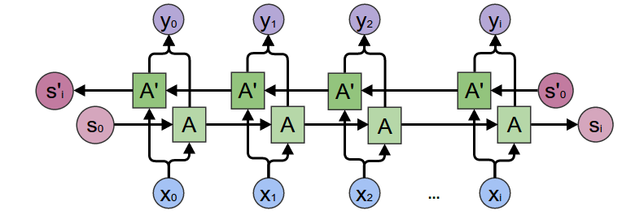
BiDirectional LSTM (BiLSTM)
In BiLSTM it preserves both past and future memory as it learns from both the side.
Example:
For sentence:
“Apple is something that competitors simply cannot
reproduce.”
“Apple is something that…”
When LSTM fails as it don’t know whether it is about fruit or
company.
BiLSTM performs well as it knows the future context.

Slide 13
Models designs for this experiment.

Slide 14
Models implemented:
BERT model (Base line)
BERT embeddings + MLP (Model 2)
BERT embeddings + BiLSTM (Model 3)
GLOVE embeddings + hate words + LSTM (Model 4)

Slide 15
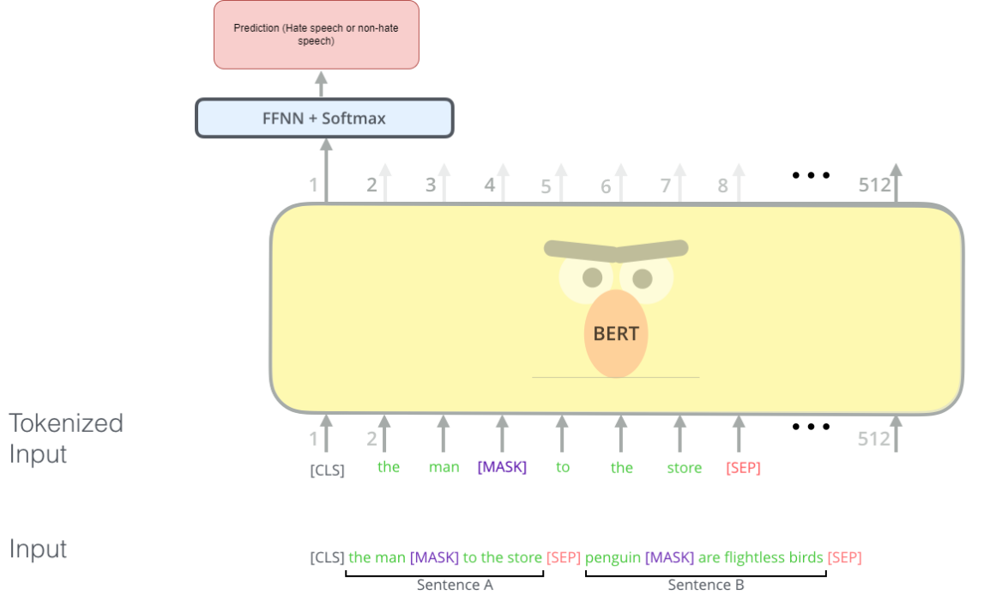
BERT model (Baseline model- Model 1)
My baseline model is simple BERT (uncased) from hugging face.
Input to this model is just text data which may or may not contain hate speech.
Output to this model is predicted label.

Slide 16
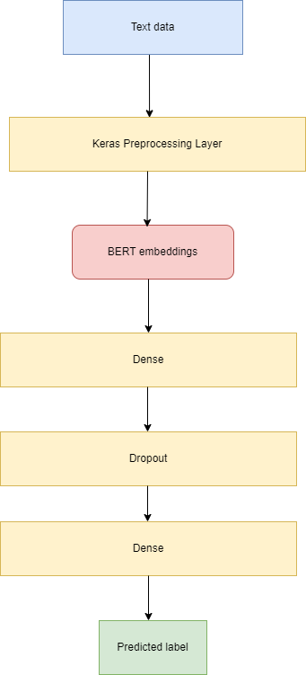
BERT embeddings + MLP (Model 2)
Here input layer is text data which is preprocessed to get BERT embeddings.
These embeddings is fed to two hidden layers with dropout in between.
Here I’m using ’pooled output’ from the BERT embeddings.

Slide 17
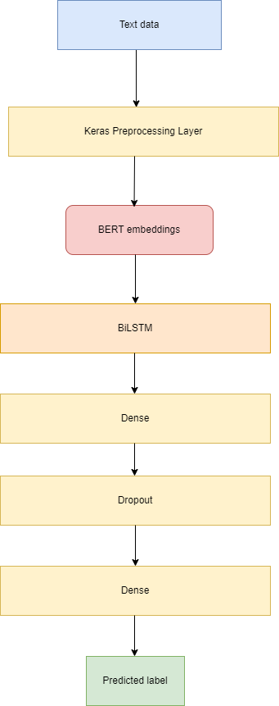
BERT embeddings + BiLSTM (Model 3)
Here the model is similar to Model 2.
The difference is it has an extra BiLSTM layer where input is BERT embeddings.
Here I’m using ’sequence output’ from the BERT embeddings.

Slide 18
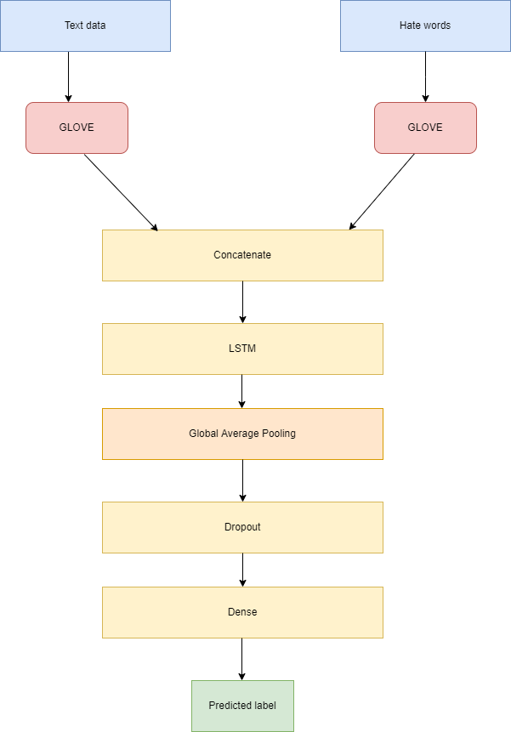
GLOVE embeddings + hate words + LSTM (Model 4 – Proposed Model)
Here other than text data one extra feature is hate words.
For example:
"How are you all? You should kill yourself" then the hate words will be "kill yourself”.
Here I’m using GLOVE embeddings as it gives embeddings irrespective of context, making my model compare text data and hate words easily.

Slide 19
Results and Analysis

Slide 20
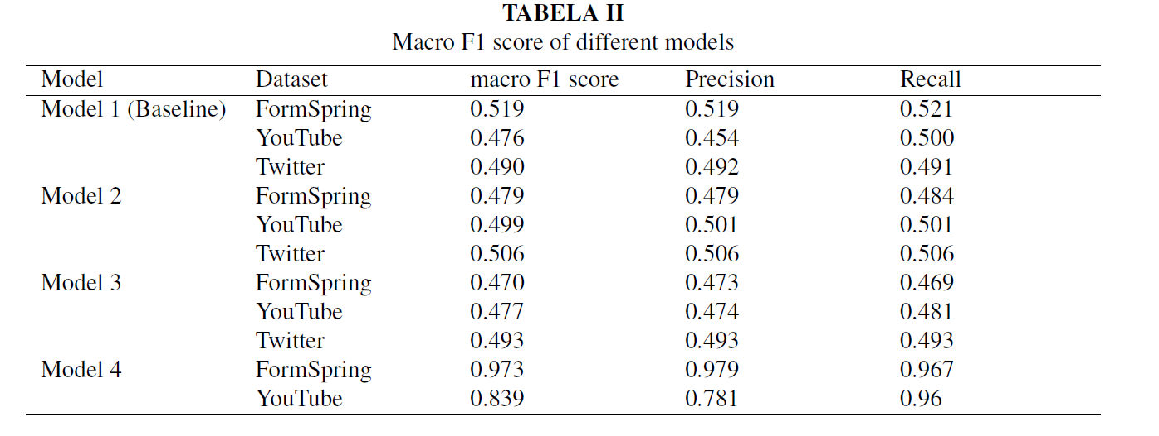
Evaluation metrics:
It can be observed that Model 4, that is, our proposed model, has outperformed other models with a pretty big margin.

Slide 21
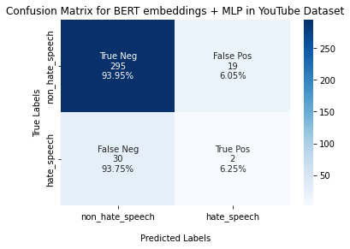
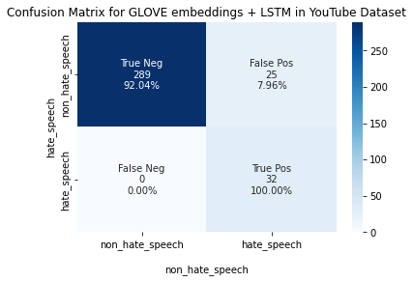
Confusion matrix on YouTube dataset
Model 2 on the YouTube dataset predicted 93.95% for True negative (non-hate speech) and only 6.25% for True positive class (Hate speech). This might not be the best model for us yet.
Model 4(proposed model) can predict our True positive class (Hate speech) correctly and with a 92.04% prediction rate for non-hate speech. This is the best model as it can predict our required class perfectly.

Slide 22
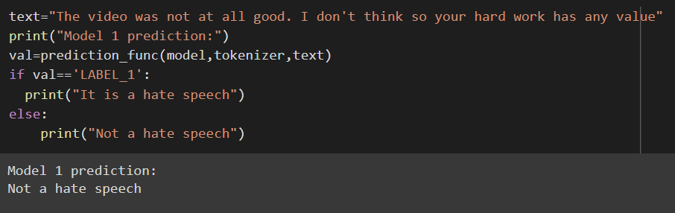
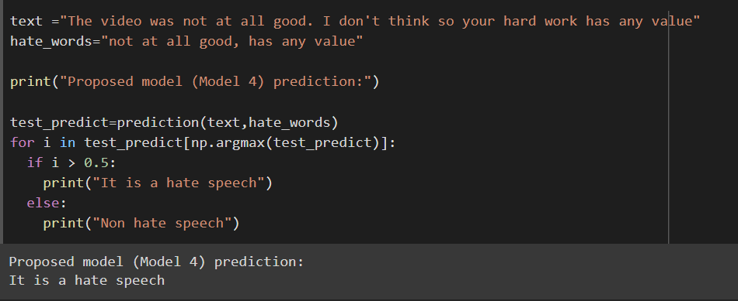
Prediction analysis:
Model 1 prediction:
Model 4 prediction :

Slide 23
Future Work
We can train an unsupervised learning model on FormSpring and YouTube datasets to extract hate words from it. This same model can be used on the Twitter dataset to extract the hate words from it.
Here we have just used one feature. We can use other features such as n-grams for further experiments.
We can deploy this model for real-world hate detection on social media.

Slide 24
Note: All the images presented in this slide is taken from the internet except the model architecture of Model 2,3,4 and result images.

Slide 25
Thank You

